Slide 1

September 2022 Data Discovery Project

Slide 2


Slide 3

2023 Requirement:
EP 3: The [organization] identifies health care disparities in its [patient] population by stratifying quality and safety data using the sociodemographic characteristics of the [organization’s] [patients].
Note 1: [Organizations] may focus on areas with known disparities identified in the scientific literature (for example, [Hospital/Critical Access Hospital: organ transplantation, maternal care, diabetes management; Ambulatory Health Care: kidney disease, maternal care, diabetes management; Behavioral Health Care: treatment for substance abuse disorder, restraint use, suicide rates]) or select measures that affect all [patients] (for example, experience of care and communication).
Note 2: [Organizations] determine which sociodemographic characteristics to use for stratification analyses. Examples of sociodemographic characteristics may include the following:
• Age
• Gender
• Preferred language
• Race and ethnicity
Health care disparities are ubiquitous for members of racial/ethnic minorities, people who prefer to speak a language other than English, women, older patients, people with disabilities, and other historically marginalized groups.17 Therefore, it is essential for organizations to conduct analyses to understand the specific disparities that may exist at their institution. This process begins with stratifying existing measures.18-20 Organizations may also wish to measure differences in care processes, procedure use, and outcomes for high-risk topics where research has shown disparities are common and substantial. If stratified analyses show differences across groups, organizations should work to understand the root causes of the differences and develop actions to address disparities when they are identified (See EP 4).

Slide 4

Data

Slide 5
Questions of Interest:
What disparities exist in related to incidents?
Do certain groups have more incidents?
Do certain groups have different kinds of incidents?
Does one kind of incident predict another?
Do certain kinds of incidents happen more often at certain times of year?
Do incidents happen more often at a particular day of service?

Slide 6
What has already been done?
Simple trends are created/viewed each quarter.
Particular focus on “suicide incidents”.
Comparison to external data.
Comparison with COVID-IRs.

Slide 7
Suicide-Related Indicators:
PG/7 TJC Preparation Priorities August 2021

Slide 8
Youth Suicide by Age Group:
Data Source: As cited on kidsdata.org, California Dept. of Public Health, EpiCenter (Feb. 2020); California Dept. of Finance, Population Estimates and Projections (Jan. 2020); CDC, WISQARS (May 2020).

Slide 9

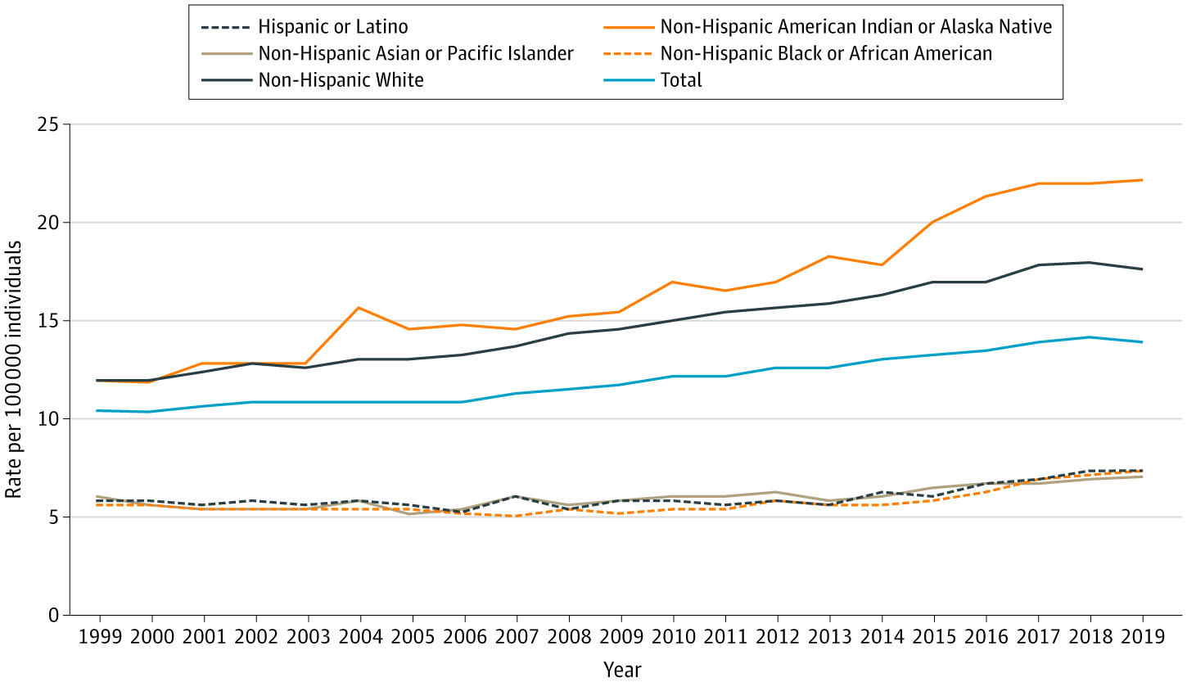
From: Trends in Suicide Rates by Race and Ethnicity in the United States
JAMA Netw Open. 2021;4(5):e2111563. doi:10.1001/jamanetworkopen.2021.11563
Figure Legend:
Age-Adjusted Suicide Rates by Race/Ethnicity, 1999 to 2019

Slide 10
Youth Suicide by Ethnicity :

Slide 11
Youth Suicide by Gender:
Source: Lee, J., Bang, Y.S., Min, S. et al. Characteristics of adolescents who visit the emergency department following suicide attempts: comparison study between adolescents and adults. BMC Psychiatry 19, 231 (2019). https://doi.org/10.1186/s12888-019-2213-5

Slide 12
Infection Control IRs:
PG/12 TJC Preparation Priorities 05/11/21

